Slide 1
x86 Assembly Part 3 and Y86-64

Slide 2
Practice Question
int arith(int x) {
return ??????;
}
mov 0x4(%esp),%edx
leal 3(%edx), %eax
testl %edx, %edx
cmovns %edx, %eax
sarl $2, %eax
ret

Slide 3
Practice Question
int arith(int x) {
return x / 4;
}
mov 0x4(%esp),%edx
leal 3(%edx), %eax
testl %edx, %edx
cmovns %edx, %eax
sarl $2, %eax
ret

Slide 4
Challenge Question 1
What is stack randomization?
How to launch a NOP Sled Attack?
And how to defend against it?

Slide 5
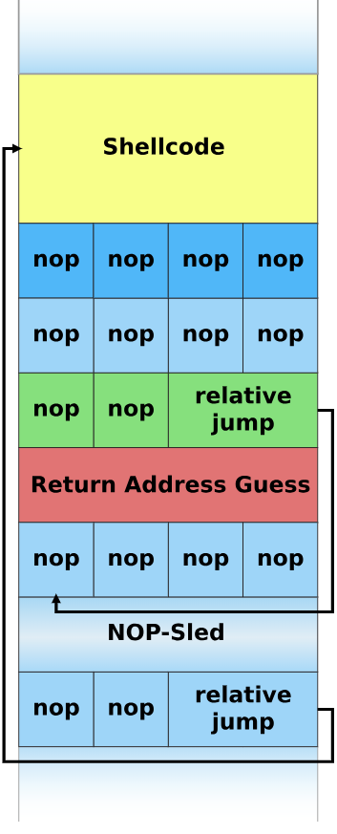
Challenge Question 1 - Attack
Pray for having Return Address fallen in the range of NOP
Other instructions which have same effect as NOP are interchangeable
address
increase

Slide 6
Challenge Question 1 - Defense
Page permission checking will block NOP Sled Attack
Return Oriented Programming (ROP) cannot be prohibited by randomized stack
Page permission checking have no effect, either.

Slide 7
Challenge Question 2
What is the canary?
Where is it?
How does it work?
Can we crack it?

Slide 8
Challenge Question 2 - Location
……
Prev. Frame
Canary stands between the buffer and return address.
Its value is randomly initialized upon each run.
Canary is stored on the stack when enter the function and examined at leave.
Return Addr.
Something
Canary
Buffer
address
increase

Slide 9
Challenge Question 2 - Attack
It is hard to bypass a canary.
When there are other bugs which might leak information about the canary, you get a chance.
Or, if the target is a daemon program that uses fork(), we might use exhaustive search.

Slide 10
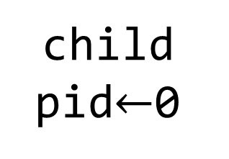
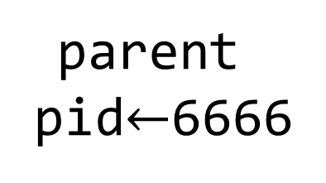
Challenge Question 2 - Attack
pid = fork()
fork() is used to create a new process.
Except the return value pid, all other context is same.
Use pid to branch between parent and child.
parent
pid$←$6666
child
pid$←$0

Slide 11
Challenge Question 2 - Attack
Attack the child.
Even if the child crashes, the parent is remained running, and canary value unchanged!
One will eventually succeed.

Slide 12
That’s all for today.

